Slide 1
AMS STAC Chairs
Annual Meeting 2026
Clark Evans, Commissioner
Kristie Franz, Past Commissioner
Stephen Bieda, Incoming Commissioner
January 25, 2026

Slide 2
Agenda
11:00 am Welcome and introductions
11:15 am Information and reminders
11:55 am Group photo
12:00 pm Working Lunch
12:30 pm Summary of working lunch discussions + potential AMS leadership visits
12:45 pm Discussion on the future of specialty meetings
1:05 pm Discussion on conference, symposium, and workshop sponsorship and finances
1:25 pm Discussion on board and committee leadership and membership practices
1:45 pm Open discussion and final thoughts
2:00 pm Adjourn

Slide 3
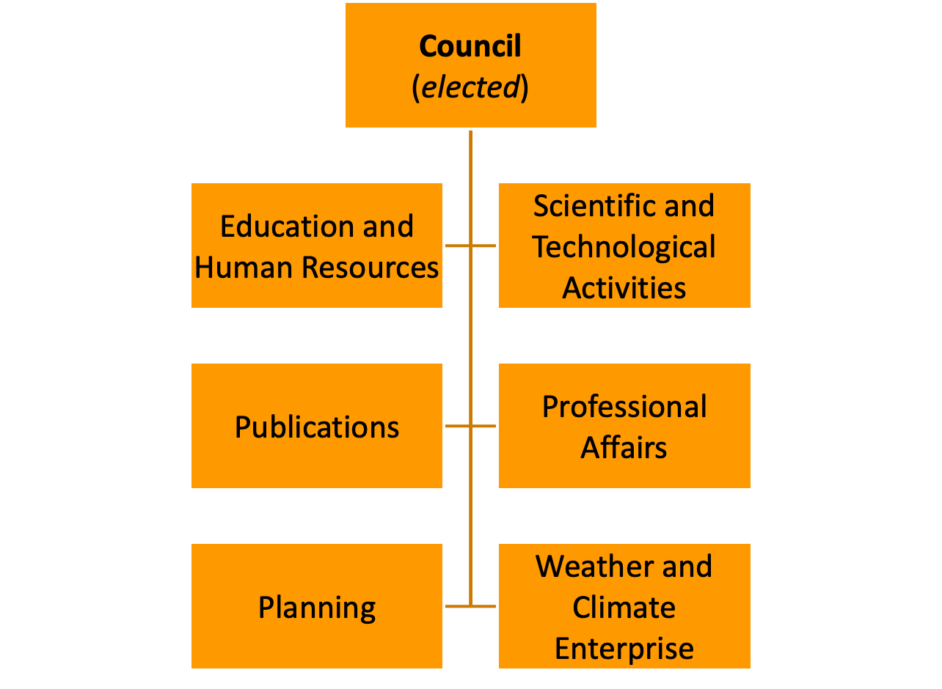
What is STAC
The Scientific and Technological Activities Commission
One of six AMS commissions
Responsible for many key activities of AMS: most meetings, contributions to statements, webinars, volunteer opportunities, named sessions/symposia, Glossary of Meteorology, short courses, awards (AMS, STAC, student), and membership engagement in policy, enterprise, profession, publications, training.

Slide 4
Who is STAC?
STAC is the largest of AMS’s Commissions!
480 members on 6 boards and 30 committees – 24 more members than last year!
421 regular members and 59 student members
STAC represents over 1/3 of all AMS volunteers!
Relative to 2024, government representation is down (29 → 22%), whereas “no affiliation” is up (4 → 16%).
Affiliation | Count | Percent
Academic | 192 | 40%
Government | 104 | 22%
Private Sector | 13 | 3%
Student | 59 | 13%
International | 36 | 8%
None Listed | 76 | 16%
Total | 480 | --

Slide 5
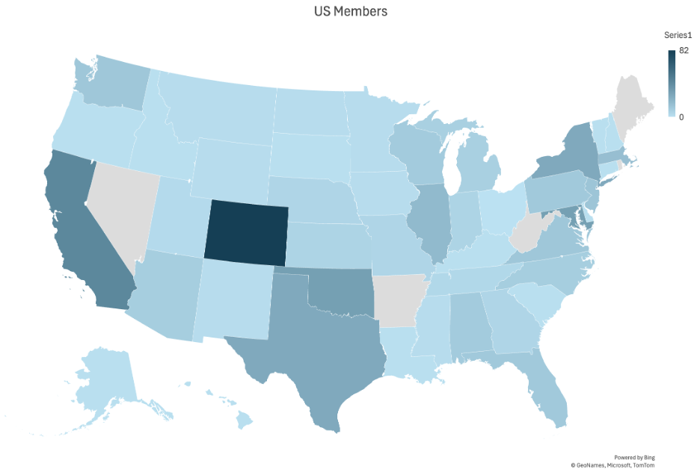
Where is STAC?
The largest volunteer counts are Colorado (82), California (43), and Maryland (31).
STAC also contains volunteers from 17 countries: Australia (3), Benin, Brazil (2), Canada (7), Chile, China (3), Egypt, France, Germany (2), Italy, Japan (2), Netherlands (3), South Africa (3), Sweden, Switzerland (2), and the United Kingdom (4).

Slide 6
Leadership and Transitions
STAC has three Commissioners, with each holding their position for two years (for a total of a six-year commitment).
This summer and fall, we will be searching for a new Incoming Commissioner as Kristie’s six-year tenure as a STAC Commissioner will be coming to an end. Please reach out to any of us if you’d like to know more details about the opportunity.

Slide 7
Clark Evans, contact for: clark.evans@noaa.gov
Board on Data Stewardship
Board on Atmospheric Biogeosciences
Board on Environment and Health
Board on Societal Impacts
Committee on Applied Climatology
Committee on Climate Variability and Change
Committee on Meteorological Aspects of Air Pollution
Committee on Polar Meteorology and Oceanography
Committee on Probability and Statistics
Committee on Atmospheric and Oceanic Fluid Dynamics
Committee on Space Weather
Committee on Weather Analysis and Forecasting

Slide 8
Kristie Franz, contact for: kfranz@iastate.edu
Board on Environmental Information Processing Technologies
Board on the Urban Environment
Committee on Air-Sea Interactions
Committee on Aviation, Range, & Aerospace Meteorology
Committee on Hydrology
Committee on Measurements
Committee on Mesoscale Processes
Committee on Meteorology and Oceanography of the Southern Hemisphere
Committee on Mountain Meteorology
Committee on Satellite Meteorology, Oceanography, and Climatology
Committee on Severe Local Storms
Committee on Tropical Meteorology & Tropical Cyclones

Slide 9
Stephen Bieda, contact for: stephen.bieda@noaa.gov
Committee on Artificial Intelligence Applications to Environmental Science
Committee on Atmospheric Chemistry
Committee on Atmospheric Electricity
Committee on Atmospheric Radiation
Committee on Boundary Layers and Turbulence
Committee on Cloud Physics
Committee on Coastal Environment
Committee on Laser Atmospheric Studies
Committee on Middle Atmosphere
Committee on Planned and Inadvertent Weather Modification
Committee on Radar Meteorology
Committee on Agricultural and Forest Meteorology

Slide 10
How we communicate to you
AMS Community – separate groups for Chairs and Vice Chairs, all Board and Committee members, and for each Board/Committee
This annual meeting (Jan)
Bi-annual telecons (May/Oct)
Quarterly newsletter (roughly Feb/May/Aug/Nov)
Are these methods working for you all? What suggestions do you have for improving our communication to you?

Slide 11
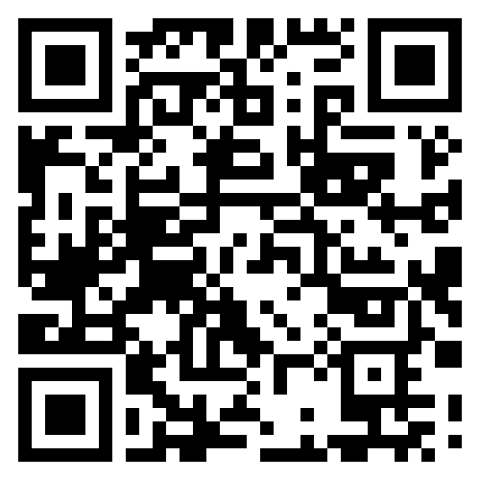
How you communicate to us
Invite us to your STAC Board/Committee meetings
  Clark and Kristie will be stopping by all B/C meetings held this week in Houston, and all are happy to join your next virtual meeting if desired!
Email us with questions – we are your conduit to AMS Staff, Council, and other Commissions
Email us with membership updates
Reports : annual updates, 5-year strategic plans, terms of reference
Conference reports: https://forms.gle/AxWoPz6928dfkkEr8

Slide 12
Thank You to our Departing Chairs!
Joe Alfieri — Board on Atmospheric Biogeosciences
Cecilia Ferriz — Committee on Polar Meteorology and Oceanography
Yu Zhang — Committee on Probability and Statistics
Heather Holbach — Committee on Air-Sea Interaction
Ryan Decker — Committee on Aviation, Range, and Aerospace Meteorology
Howard Diamond — Committee on Meteorology and Oceanography of the S. Hemisphere
Christina Kumler — Committee on AI Applications to Environmental Science
Eduardo Santos — Committee on Agricultural and Forest Meteorology
Elizabeth DiGangi – Committee on Atmospheric Electricity
Clara Orbe – Committee on Middle Atmosphere
Jim Kurdzo – Committee on Radar Meteorology

Slide 13
Welcome to our Incoming Chairs!
Nate Brunsell — Board on Atmospheric Biogeosciences
Patrick Taylor — Committee on Polar Meteorology and Oceanography
Julia Velletta — Committee on Probability and Statistics
Luc Deike — Committee on Air-Sea Interaction
Scott Startz — Committee on Aviation, Range, and Aerospace Meteorology
Mary-Jane Bopape — Committee on Meteorology and Oceanography of the S. Hemisphere
Aaron Hill — Committee on AI Applications to Environmental Science
Sasha Ivans— Committee on Agricultural and Forest Meteorology
Michael Peterson – Committee on Atmospheric Electricity
Peter Hitchcock – Committee on Middle Atmosphere
David Schvartzman – Committee on Radar Meteorology
Please let us know if we’ve missed a leadership transition or if your Board/Committee has one that has not yet been reported!

Slide 14
Congratulations to the 2026 STAC Distinguished Scientific/Technological Accomplishment Awardees!
Dr. Richard Eckman | For advancing the observation, understanding, and modeling of atmospheric composition and its role in the Earth System. | Committee on Atmospheric Chemistry
Siegfried Raasch | For lifelong dedication to numerical innovation, rigorous scientific modeling, and global knowledge-sharing in boundary layers and turbulence. | Committee on Boundary Layers and Turbulence
George H. Bryan | For enabling mesoscale meteorology advances through creating, maintaining, and updating an open-source numerical weather prediction model for idealized studies of atmospheric phenomena. | Committee on Mesoscale Processes
TBA | To be announced at a later specialty meeting. | Committee on Planned and Inadvertent Weather Modification
TBA | To be announced at a later specialty meeting. | Committee on Tropical Meteorology and Tropical Cyclones

Slide 15
Congratulations to the 2026 STAC Outstanding Service Awardees!
Jen Henderson | For dedicated service to the societal impacts community, including promotion of the AMS Board on Societal Impacts. | Board on Societal Impacts
Eric deWeaver | For visionary leadership in climate research, fostering fundamental science, and cultivating a collaborative, inclusive scientific community. | Committee on Climate Variability and Change
Dr. Meg Fowler | For outstanding leadership and service to the Committee on Hydrology, the AMS, and the broader hydrology community. | Committee on Hydrology
Sherrie S. Morris | For outstanding management, coordination, and organization of conferences, networking, and community engagement in the SATMOC Committee. | Committee on Satellite Meteorology, Oceanography, and Climatology (SATMOC)

Slide 16
Congratulations to the 2026 STAC Outstanding Early Career Awardees!
Seth Bushinsky | For improving understanding and measurement capabilities of air-sea gas fluxes and their impact on ocean biogeochemistry. | Committee on Air-Sea Interaction
Dr. Jane W. Baldwin | For leading the AMS's Conference on Environment and Health and pioneering cross-disciplinary research on extreme heat's health impacts. | Board on Environment and Health
Dr. Chenghao Wang | For high-impact urban climate modeling contributions and leadership in advancing science, applications, and community engagement. | Board on Urban Environment
Dr. Jacob Carlin | For outstanding early-career achievements in radar meteorology that have advanced the scientific community’s understanding of weather radar polarimetry, microphysics, and data assimilation. | Committee on Radar Meteorology
Shiv Priyam Raghuraman | For advances in understanding of Earth’s radiative forcings, feedbacks, and spectral signatures. | Committee on Atmospheric Radiation
Alicia Bentley | For contributions to the National Weather Service's operational model verification system and forecast evaluations. | Committee on Probability and Statistics
TBA | To be announced at a later specialty meeting. | Committee on Severe Local Storms

Slide 17
How to be a Board or Committee Chair / Vice-Chair
Just about all you need is here:
https://www.ametsoc.org/index.cfm/stac/chair-member-information/
And in the Best Practices document:
https://www.ametsoc.org/index.cfm/stac/chair-member-information/stac-board-committee-best-practices1/
For most Boards and Committees, a Chair’s major tasks are to lead the following:
Completing conference reports
Maintain membership rosters
Organize STAC Award nominations
Maintaining the Board/Committee website
Engaging in annual/strategic planning

Slide 18
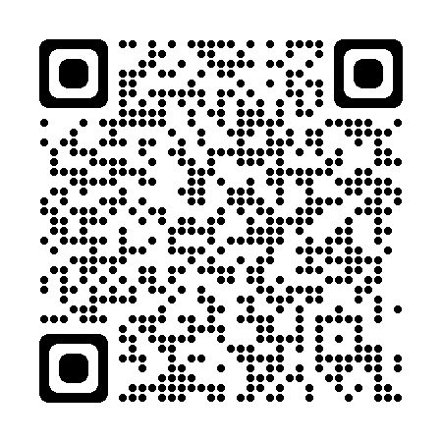
Board/Committee Membership
No matter the method by which you select members (your own or the AMS Volunteer Portal), all membership changes go through your Commissioner contact.
There are no deadlines for changes; contact us anytime.
Link to STAC Chair/Vice Chair Membership
Information page:

Slide 19
Board/Committee Membership
Membership Renewals and Changes
  Members can be renewed for a second term by informing your Commissioner contact; no nomination forms are necessary.
  Members who are moving into Chair or Vice Chair roles also do not require nomination forms for these changes.
  Members who are not renewed will automatically be removed from the Board or Committee at the end of their term.
  Members can request to rotate off early if needed upon e-mail notification from the Board/Committee Chair (or designee) to your Commissioner contact.
Stay tuned for more discussion on membership practices later in this meeting…

Slide 20
Announcements
Terms of Reference – please review (and update) your Terms of Reference and ensure they are available on your B/C’s website.
Websites – we’re still not aware of a formal timeline for restoring B/C direct website editing access. For now, please continue to email Peter Killelea with requested updates.
Student Members – AMS requires all B/Cs to have at least one student member (pg. 5, STAC Best Practices). If you do not currently have a student member, please begin to recruit one and reach out for help if/as needed!

Slide 21
Discussion Topics
Working lunch: Engagement amidst uncertain times
The future of specialty meetings
Conference, symposium, and workshop sponsorship and finances
B/C membership and leadership practices (time permitting)

Slide 22
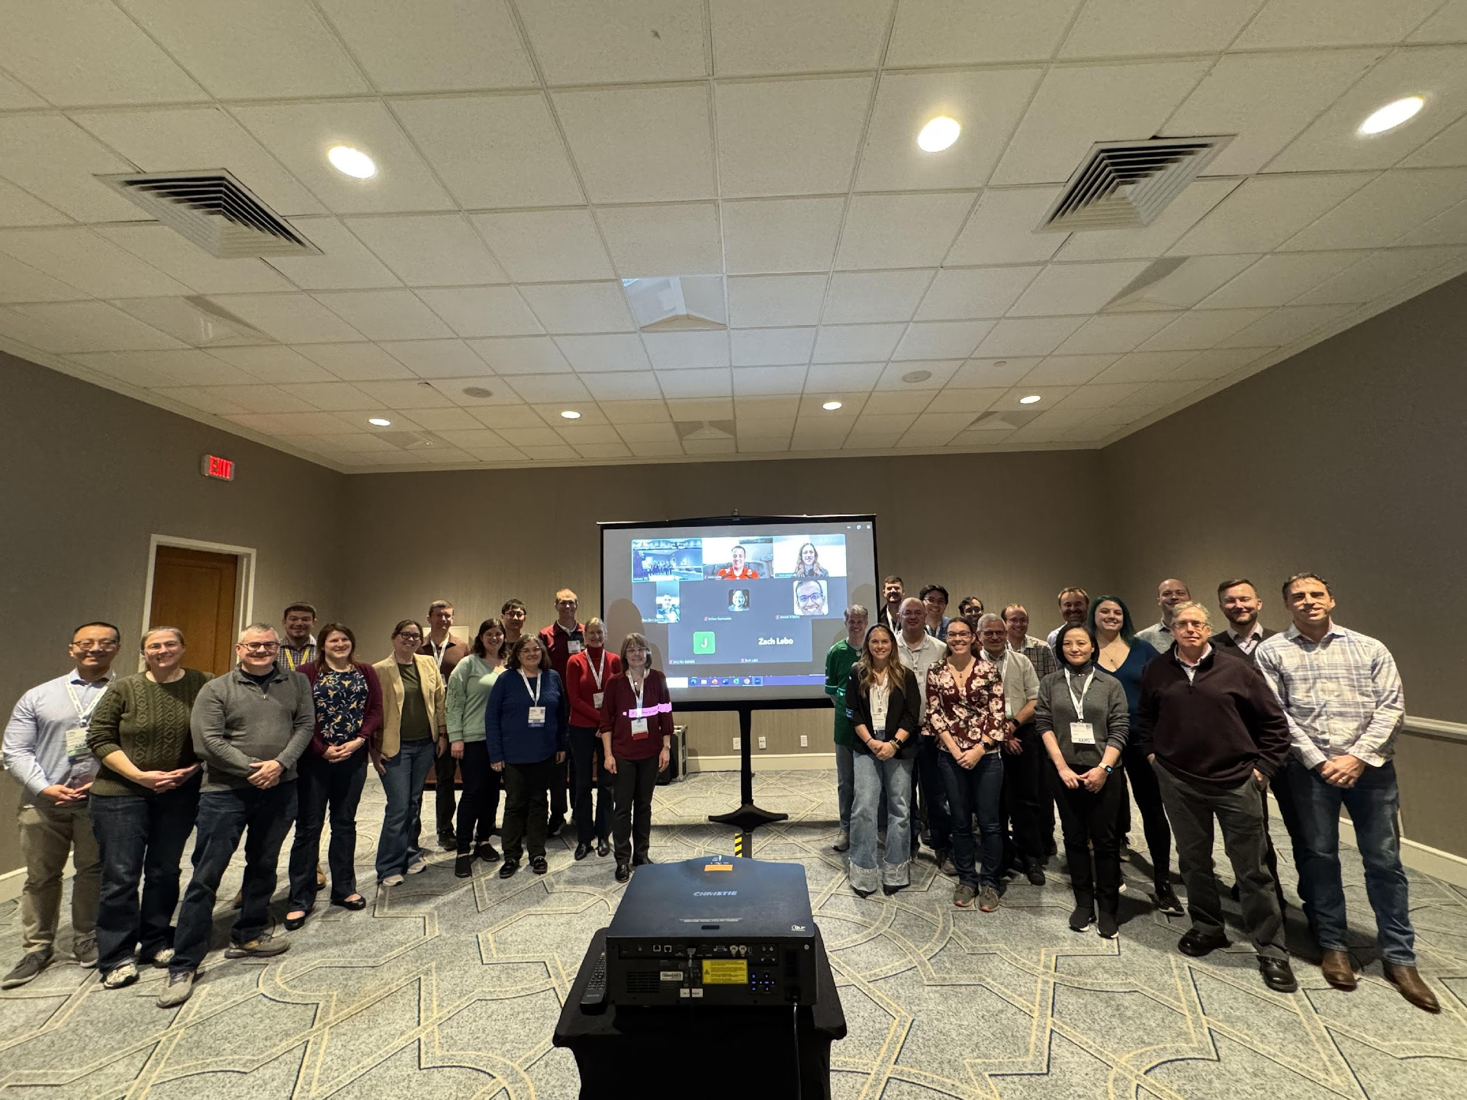
Group Photo
January 2025, New Orleans

Slide 23
Working Lunch

Slide 24
Engagement Amidst Uncertain Times
2025 was a rough year for the community in many respects.
While Board and Committee membership is up by ~5% going into 2026, we recognize this does not necessarily translate into increased capacity/bandwidth.
How did your Board or Committee navigate 2025, what do you feel equipped to handle in 2026, and how can the Commissioners and other Chairs/Vice Chairs help?

Slide 25
The Future of Specialty Meetings

Slide 26
Conference, Symposium, and Workshop Sponsorship and Finances

Slide 27
Board and Committee Membership and Leadership Practices

Slide 28
Membership and Leadership Practices
Does your Board or Committee have a practice of Vice Chairs becoming the next Chair? How is this working? If not, what practice does your Board or Committee use?
What is your Board or Committee’s default tenure for new Chairs/Vice Chairs?
For those leveraging the AMS Volunteer Portal to recruit new members, are you finding it helpful and easy to work with? What suggestions do you have for process-related improvements?
For those not leveraging the AMS Volunteer Portal to recruit new members, what method(s) are you using? What do you find works well or not well?

Slide 29
Open Discussion

