Slide 1
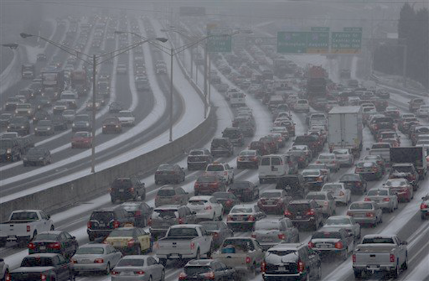

Winter Weather Forecasting and Impacts
Dr. David Novak
Director
NOAA/NWS Weather Prediction Center

Slide 2
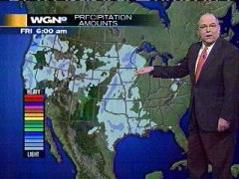
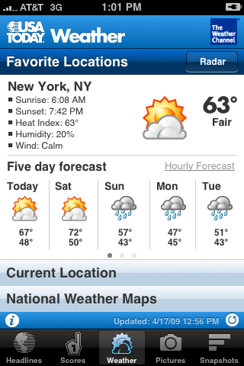
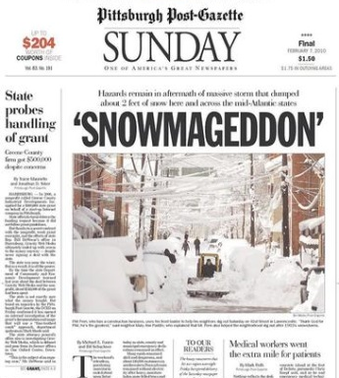


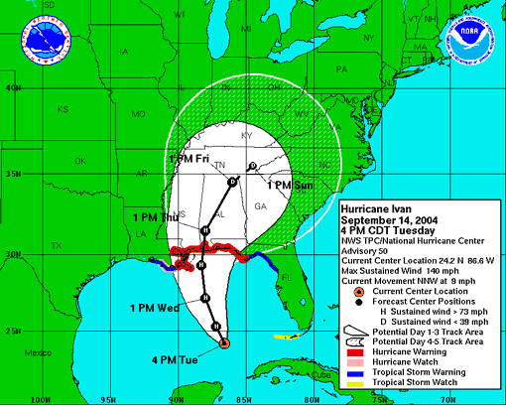
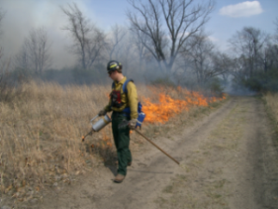
The US Weather Enterprise
A partnership
Public Sector
-Protection of life & property and enhancement of economy
Private Sector
-Provide services tailored to needs of clients & disseminates NWS warnings
Academic Sector
-Advances understanding and educates the enterprise

Slide 3
Today’s Weather Forecast
Everything you read, see or hear about weather forecasts is based on numerical prediction models
Four Essential Components of the Prediction Enterprise
Global Observations
  ~2 billion per day
Data Assimilation & Modeling/Science
Supercomputers
Forecaster Skill

Slide 4

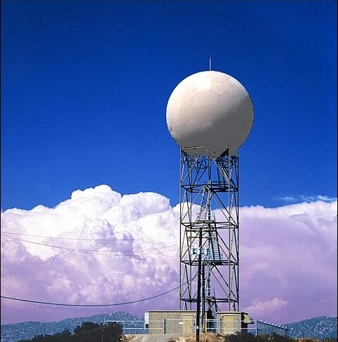
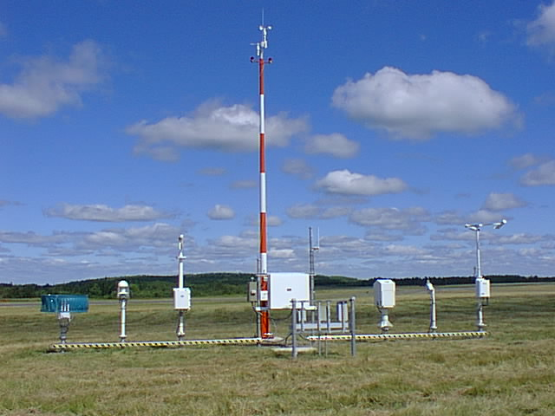
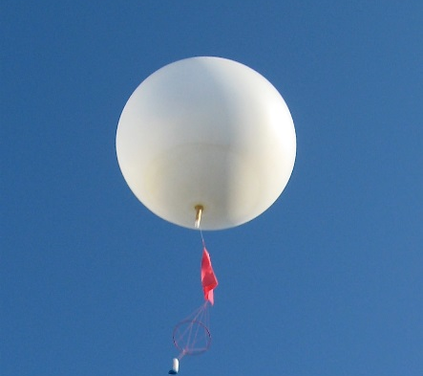

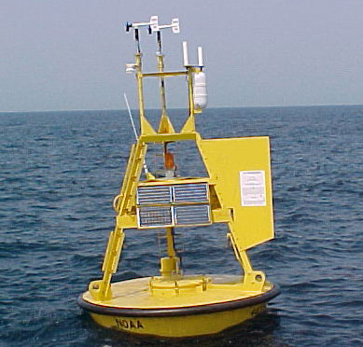
Observations
Satellites
Radars
Surface Stations
Radiosondes Aircraft Buoys
Used for situational awareness & numerical forecast models

Slide 5
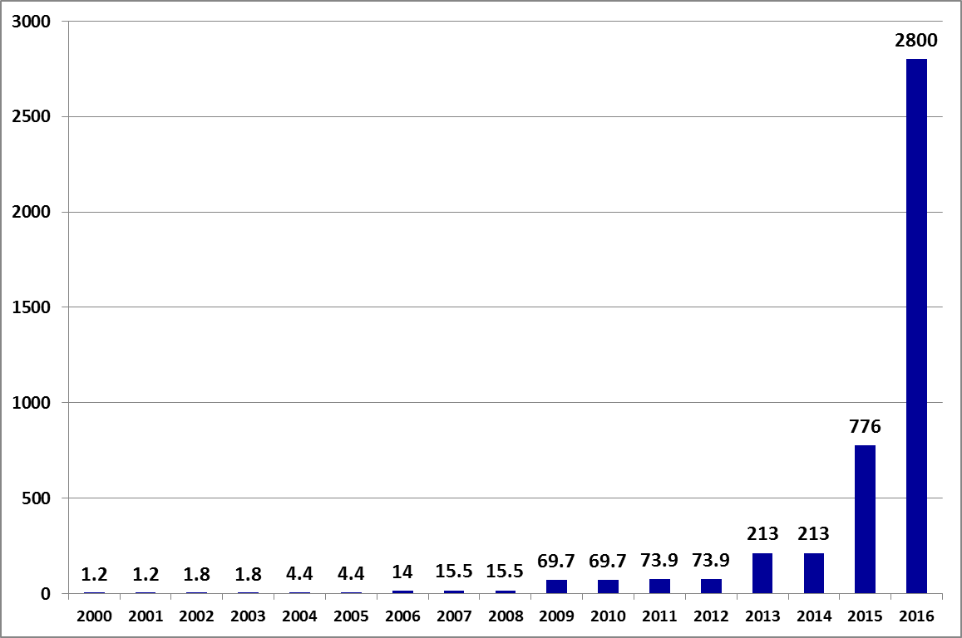
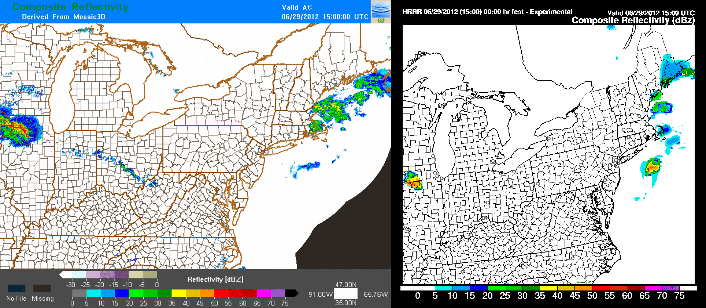
Model Science and Supercomputer
Increased HPC capacity to 2.8petaFLOPs
(for primary and backup, respectively – for a total of 5.6 PF) - Implemented.
Reflectivity Observations
HRRR 15 UTC 29 June 2012
Enabling forecasts:
farther out in time
with more detail
with greater accuracy
ECMWF
1796
TeraFLOP per operational system

Slide 6
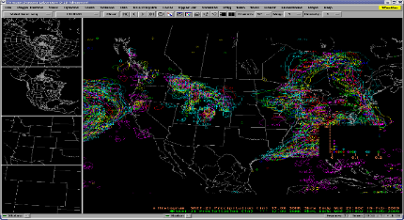
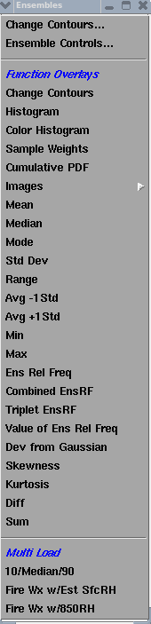
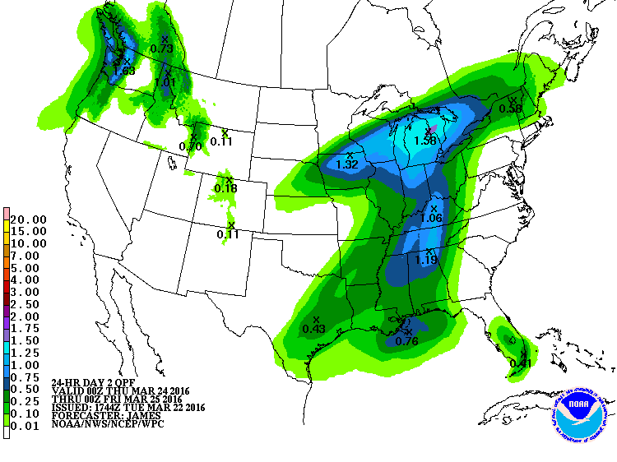
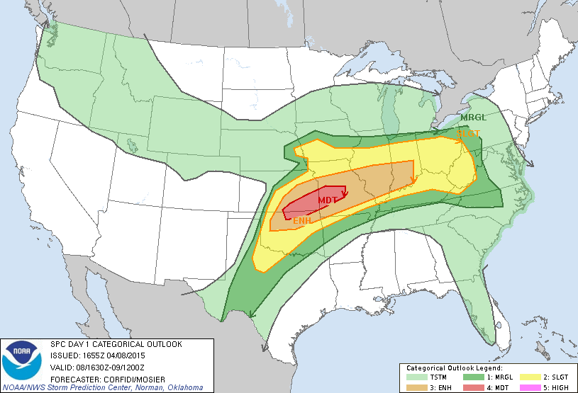
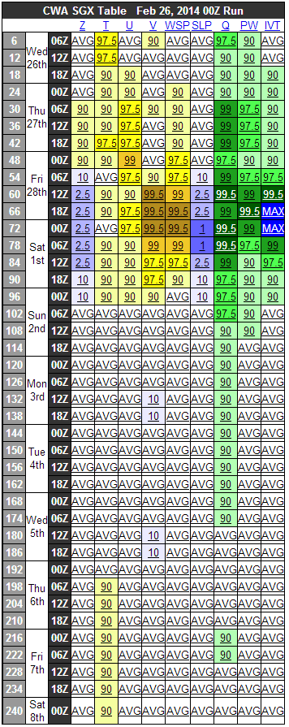
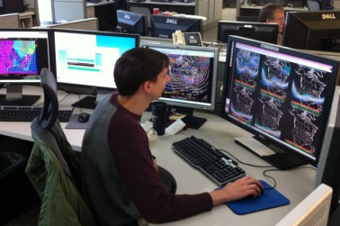
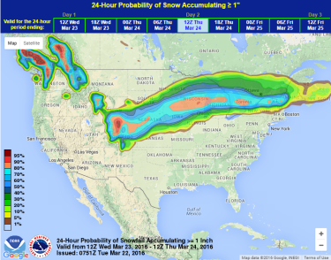
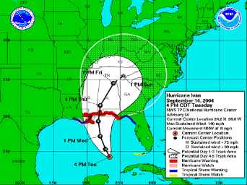
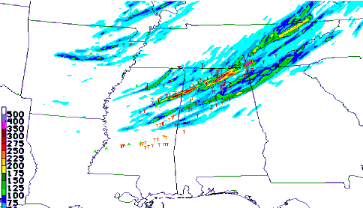
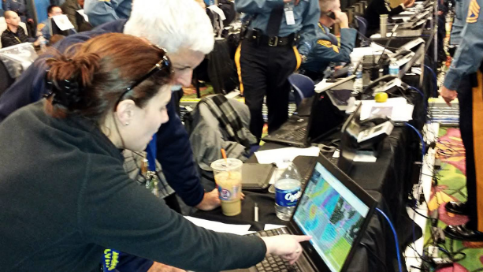
Forecaster Skill
Forecasters synthesize terabytes of data into actionable services & support decision makers

Slide 7
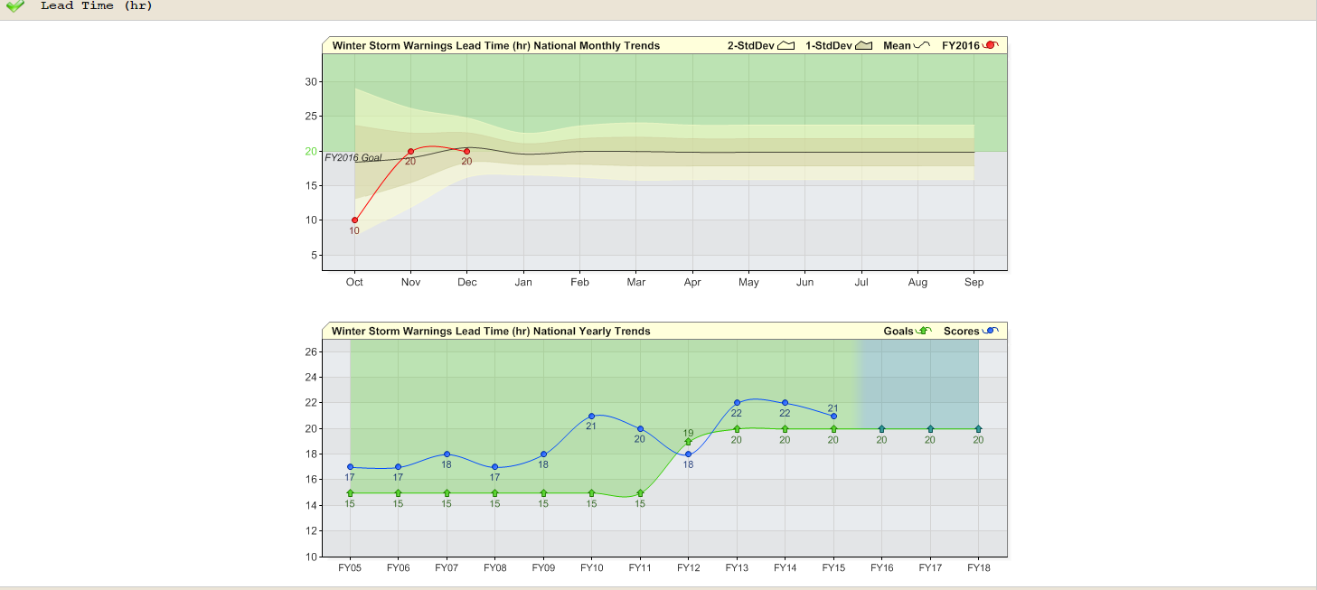
Winter Forecasts Are Improving
Winter Storm Warnings issued with 90% accuracy nearly a day in advance
Lead time increasing (30% increase past seven years)

Slide 8
But the Needs Are Tremendous
“Is it going to snow tomorrow?”
“How much is it going to snow tomorrow?”
“Will my city be immobilized?”
“Will my city be immobilized next week?”
METEOROLOGY TO IMPACTS

Slide 9
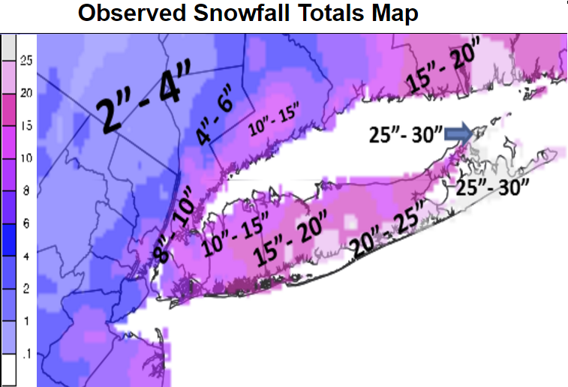
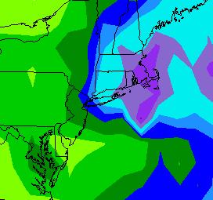
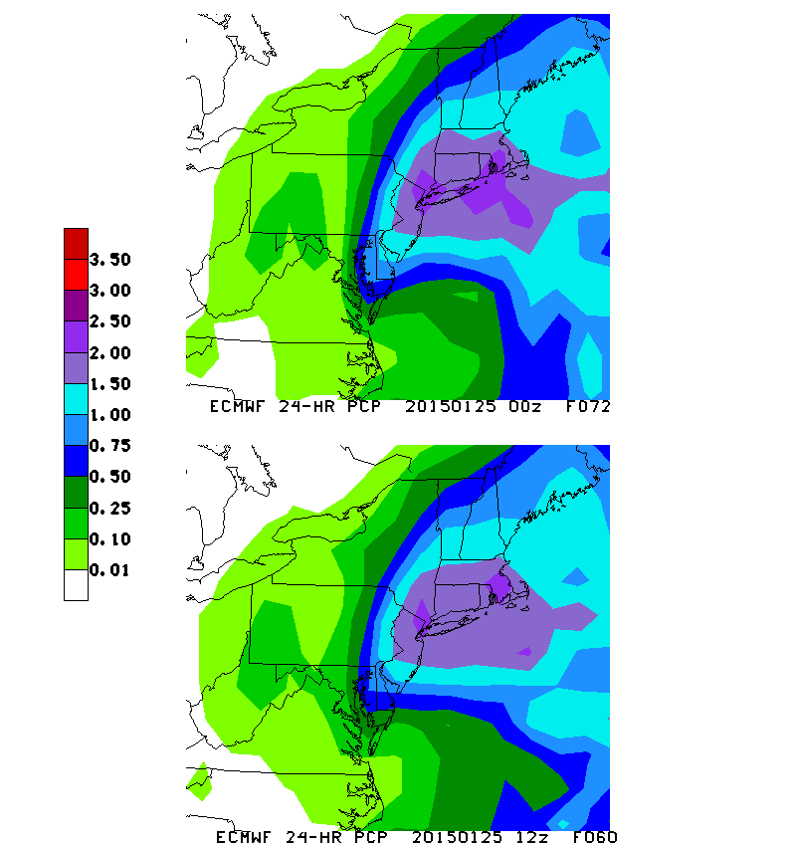
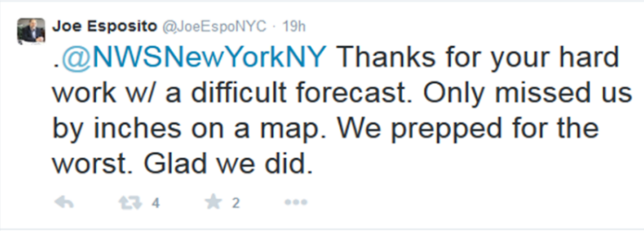
Key Challenges
Storm Track and Intensity
100 mile error can be difference between blizzard and sun
2015 January Blizzard
GFS
ECMWF
L
L
Snow Forecast*
NYC ~ 7.2 “ | BOS ~ 24”
Snow Forecast*
NYC ~ 25.2 “ | BOS ~ 24”
*Snow Forecast uses a 12:1 ratio from the precipitation forecast.

Slide 10
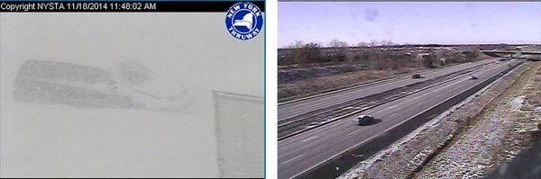
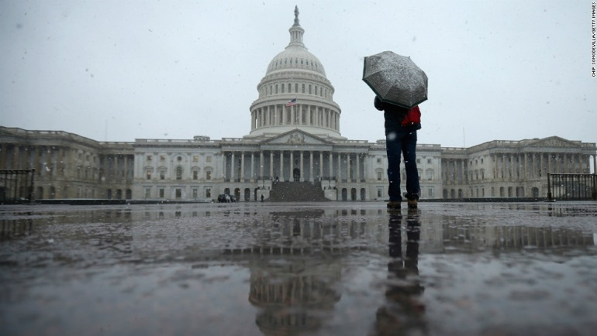
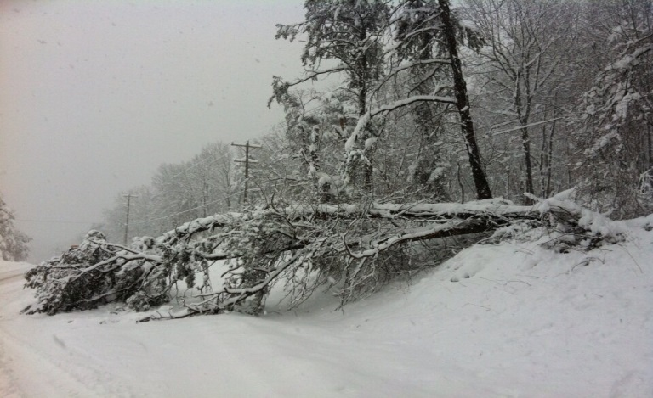
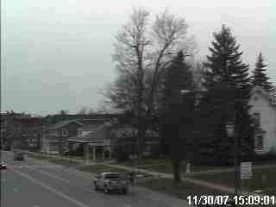
Key Challenges
Timing, Location, and Intensity
Details in timing, location, and intensity matter
Prolific Lake Effect Snow
Nov 18, 2014
‘Snowquester’
March 6, 2013
DC
6 miles
Getty
Snow Squall – November 30, 2007
Northern Virginia

Slide 11
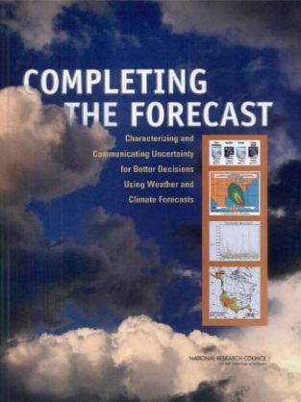
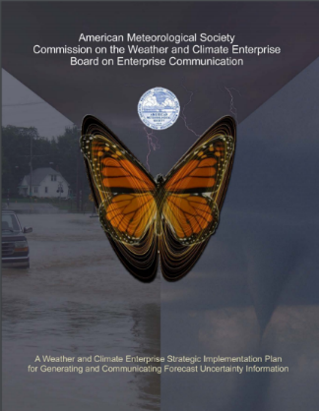
Key Challenges
Communicating Confidence
Weather Forecasts are Inherently Uncertain
2006 National Research Council Report
  “… compelling reasons for Enterprise to transition to a new paradigm … in which uncertainty is an integral and essential component of all forecasts.”
2008 American Meteorological Society
  “Ideally, all weather forecasts would include information that accurately quantifies their uncertainty.”

Slide 12
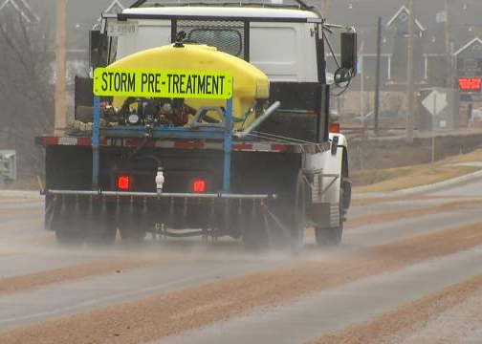

Opportunities
Cost-Loss Decision Making
Use probabilistic thresholds for key decisions
Chance of
Snow on Rd
>
Risk
Tolerance
Action
Pretreat Roads
Chance of
Heavy Snow
Action
Cancel Flights
>
=
>
Risk
Tolerance
=
=

Slide 13
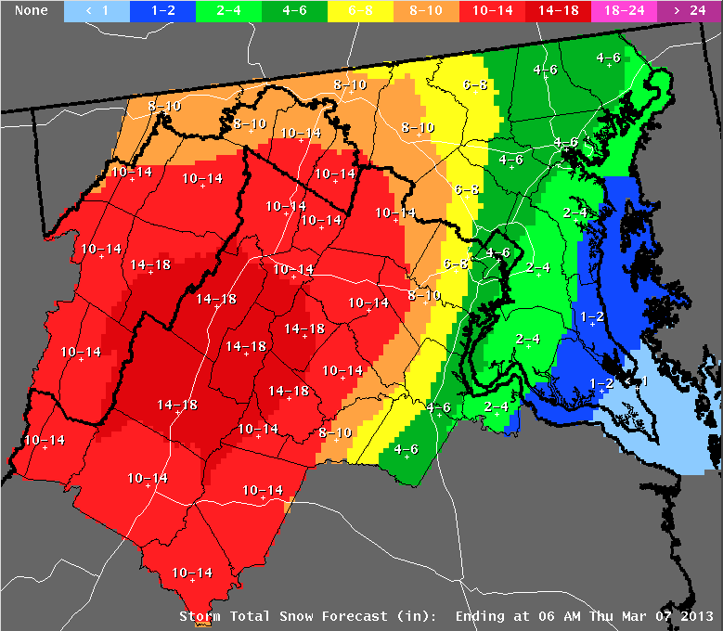
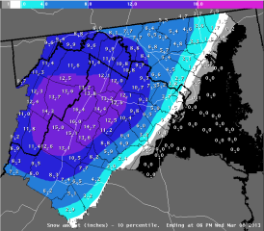
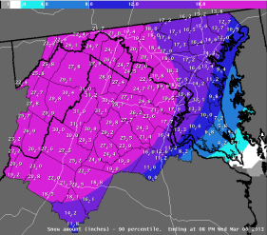
Opportunities
Alternative Scenarios
Ongoing Experiment at 18 Offices
Minimum
(1”)
Most Likely
(5”)
Maximum
(11”)
DC
DC
DC
Expect at least this much
Official NWS Forecast
Potential for this much
Positive feedback from Emergency Management Community

Slide 14
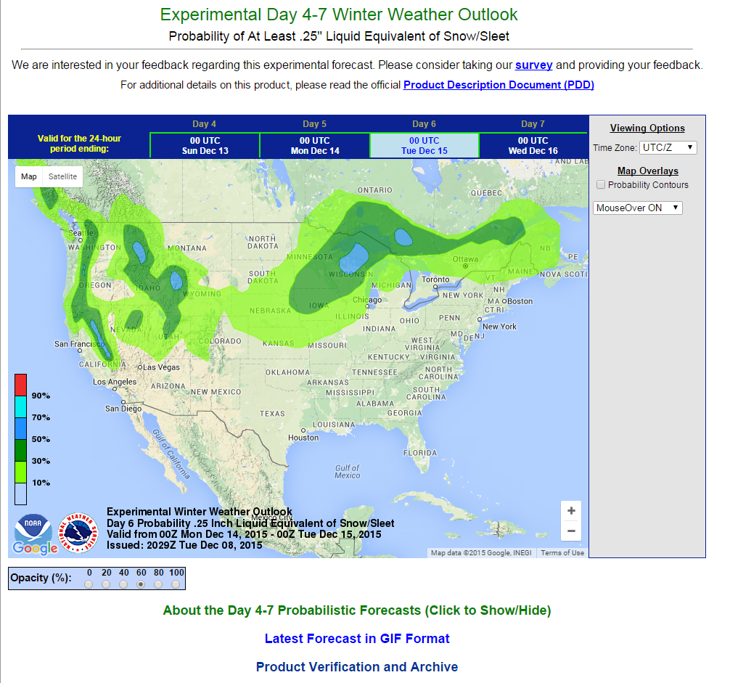
Opportunities
Extending Forecasts
Ongoing Experiment of Winter Forecasts 1 Week in Advance
Probability of plowable snowfall (~2-4”)
Publicly Experimental this season
Demonstrating skill
Positive feedback from stakeholders

Slide 15

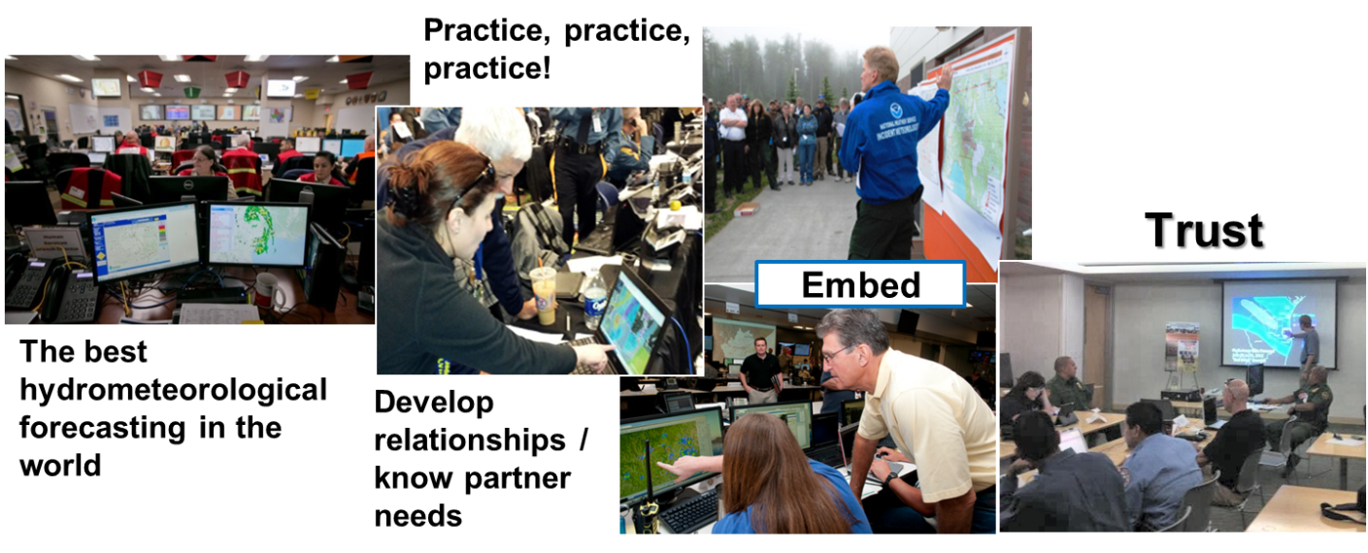
Connecting All the Pieces
NWS strategic goal is a Weather-Ready Nation
Involves entire US Weather Enterprise WORKING TOGETHER
to achieve far-reaching national preparedness for weather events
Generating forecasts
and warnings
Connecting those forecasts/warnings with key partner decisions
=
Prepared Society

Slide 16
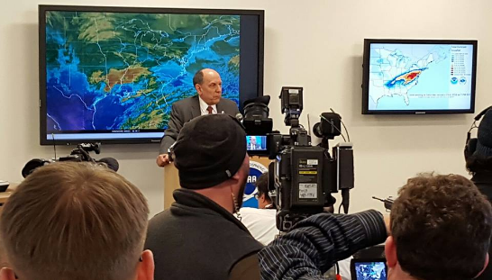
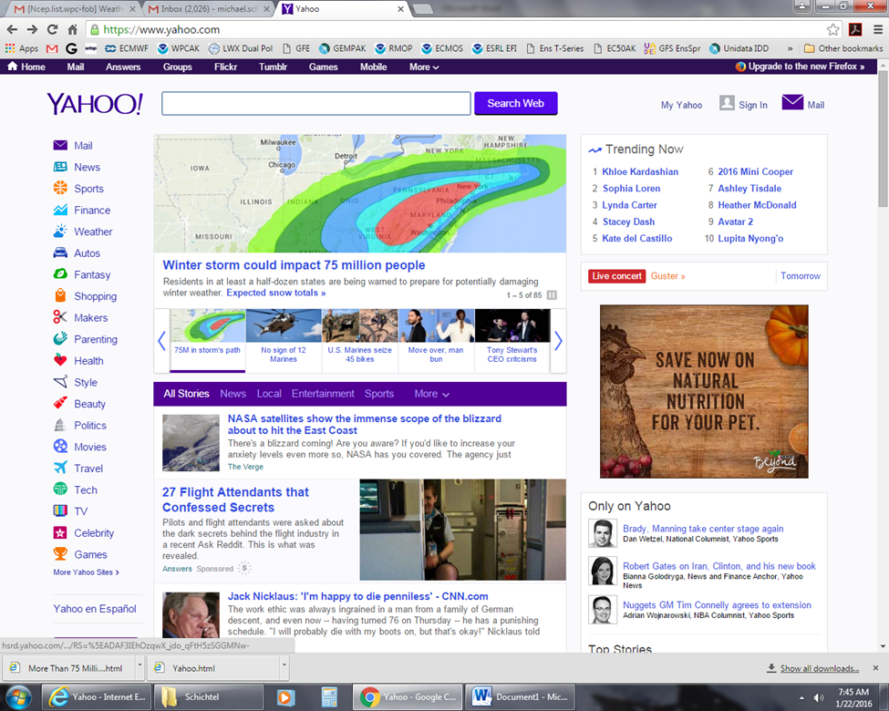
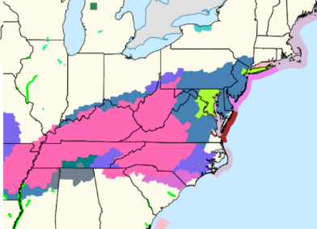
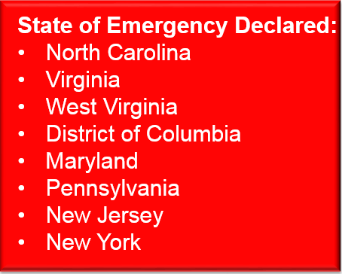
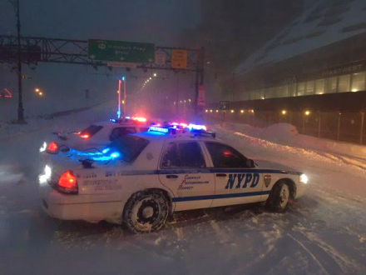
Connecting All the Pieces
January 2016 Blizzard Timeline
Jan 17 & 18
Jan 19
Jan 20
Jan 21
Jan 22
Medium Range products highlight snowstorm threat
Medium Range products highlight snowstorm threat
NWS collaboration on messaging and strategy
Alert state and local governments
National media interviews
8:30 am: NWS briefs FEMA HQ
Coordination with state and local governments
Numerous national media interviews
Blizzard Watches
Issued
8:30 am: NWS briefs FEMA HQ
Coordination with state and local governments
1 pm: National Press Briefing
Collaboration to raise snowfall in NYC area
Embed with EOCs
Schools and Government Close
Flights Canceled
Roads Closed

Slide 17
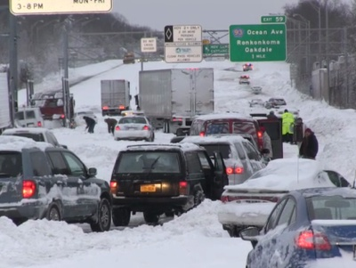
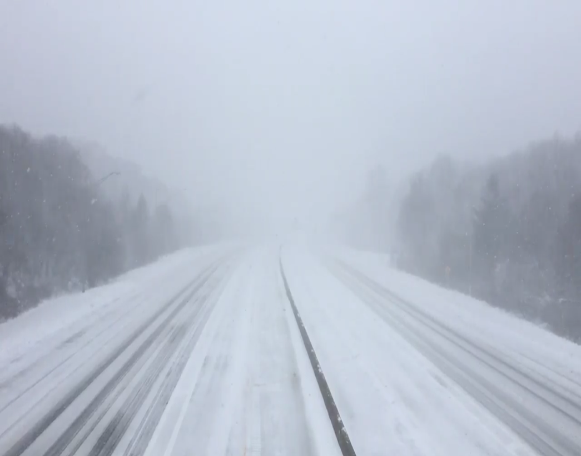
Connecting All the Pieces
Long Island Expressway
2013 Snowstorm
2016 Snowstorm
The Past
With Decision Support

Slide 18
Summary
Weather enterprise monitoring and forecasting winter weather 24x7x365
  Winter weather forecasts are improving through advances in science, modeling, and communication
  Key challenges
    Storm track and intensity
    Small scale details of storms
    Communicating confidence
  Early successes in using forecasts for key decisions by emergency management, federal partners, and state and local governments

