Slide 1



Lightning Observations and Applications
Scott Rudlosky, Ph.D.
Adjunct Assistant Professor
University of Maryland College Park
Department of Atmospheric and Oceanic Science
AMS Capitol Hill Briefing on Lightning
20 November 2014
Washington, D.C.

Slide 2
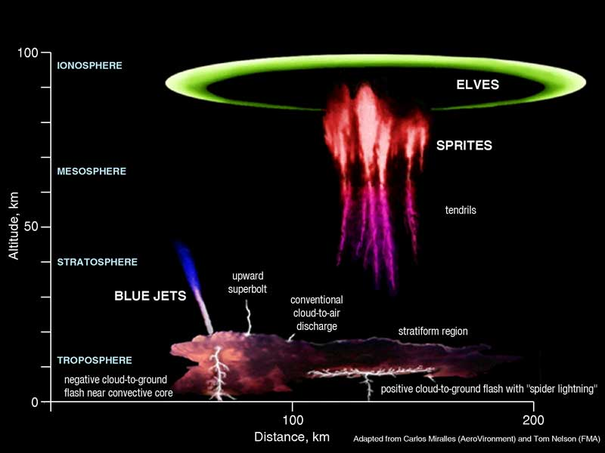
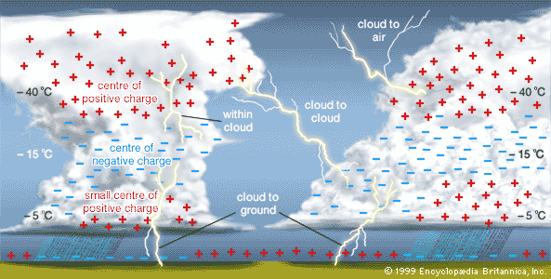
Outline and Overview
Lightning Observations
  Multi-scale lightning observations
  Ground-based network performance
  GLM specifications and benefits
Storm Warning Applications
  Lightning jumps and severe weather
  Improving precipitation estimates
  Data assimilation (modeling efforts)
  Improving hurricane intensity forecasts
  Ocean Prediction Center evaluation
Public Safety Applications
  Washington D.C. Lightning Mapping Array (DCLMA) and Rocky Mountain National Park fatalities
The Many Types of Lightning

Slide 3
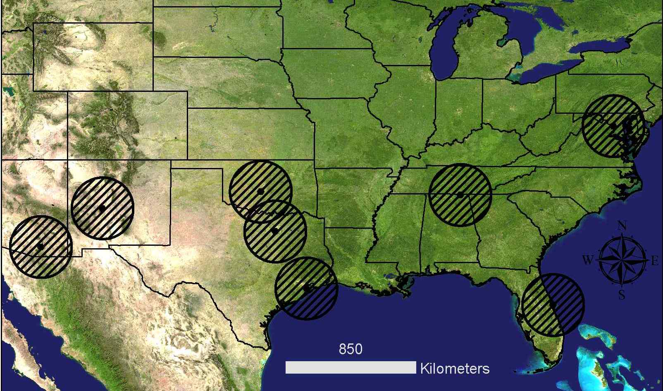
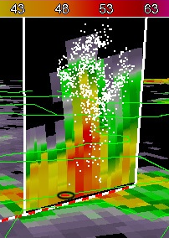
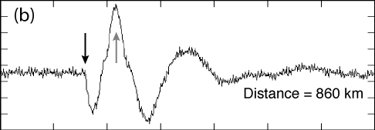

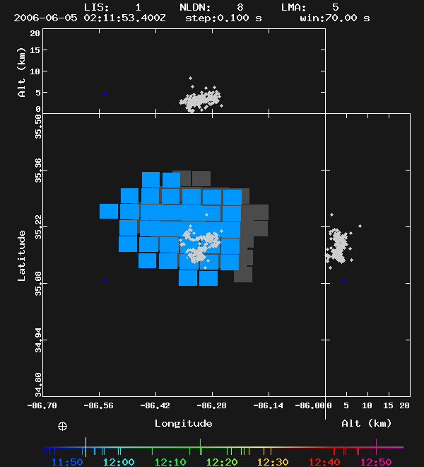
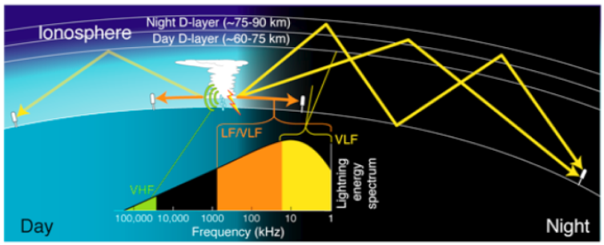
Lightning Observation Networks
“Regional” Networks
  Continental Scale
  Lightning Mapping Arrays (LMA)
“Global” Networks
  Long-Range, ground-based
  Observations from space
Present/Future LMA Locations
NASA’s Tropical Rainfall Measuring Mission (TRMM)
Long-range networks leverage ionospheric reflections
Right: Comparison of TRMM and LMA Observations (from Carey and Schultz)

Slide 4
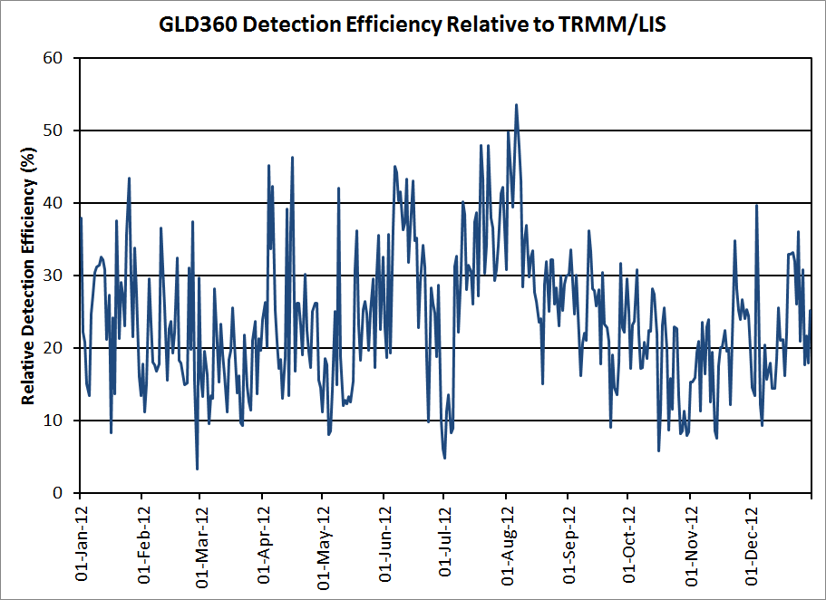
Ground-Based Lightning Network Performance
GLD360 performance relative to the TRMM Lightning Imaging Sensor (LIS) during 2012
White grid cells indicate no LIS flashes
Metric | GLD360
DE (%) | 25.3
LD (km) | 12.6
Multiplicity | 1.85
Regional DE (%) | GLD360
North America | 33.4
South America | 17.5
Oceans | 33.0
2° × 2° Grid

Slide 5
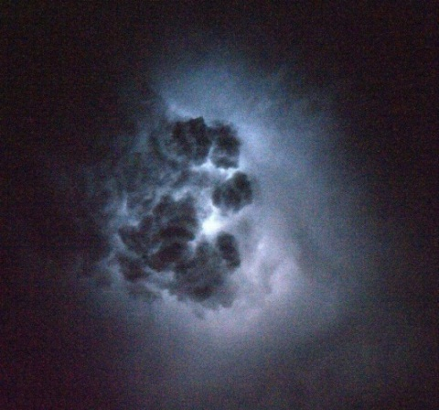
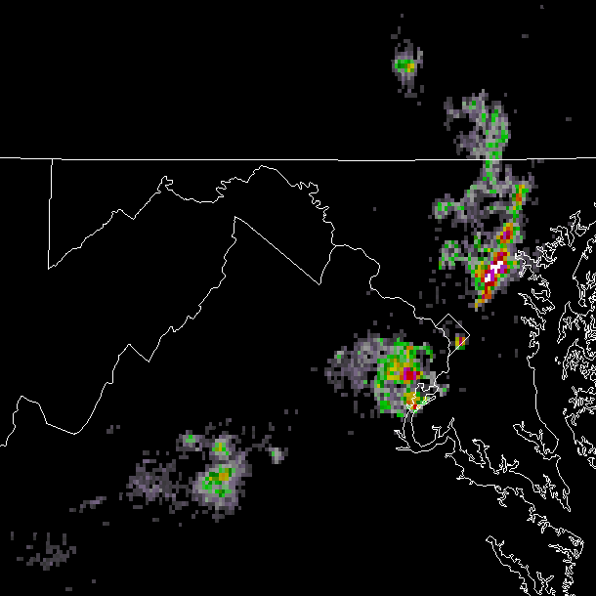
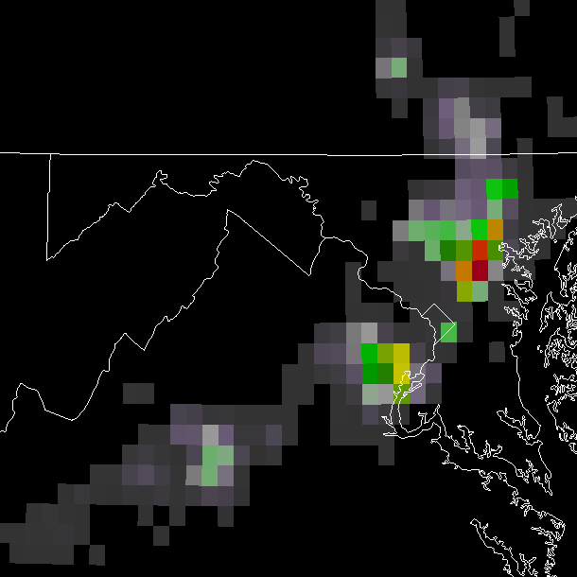
GOES-R Geostationary Lightning Mapper (GLM)
Nearly uniform performance in both space and time
GLM will observe intra-cloud (IC) and cloud-to-ground (CG) lightning
The first flash in a storm is almost always IC (and most flashes are IC)
Spatial and temporal resolutions that are currently unavailable
Must use existing networks to simulate future capabilities
Lightning as viewed from above
LMA Resolution
GLM Resolution
2×2 km
8×8 km

Slide 6
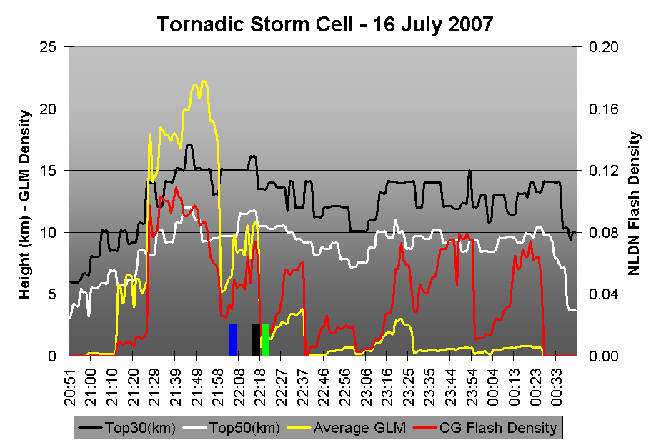
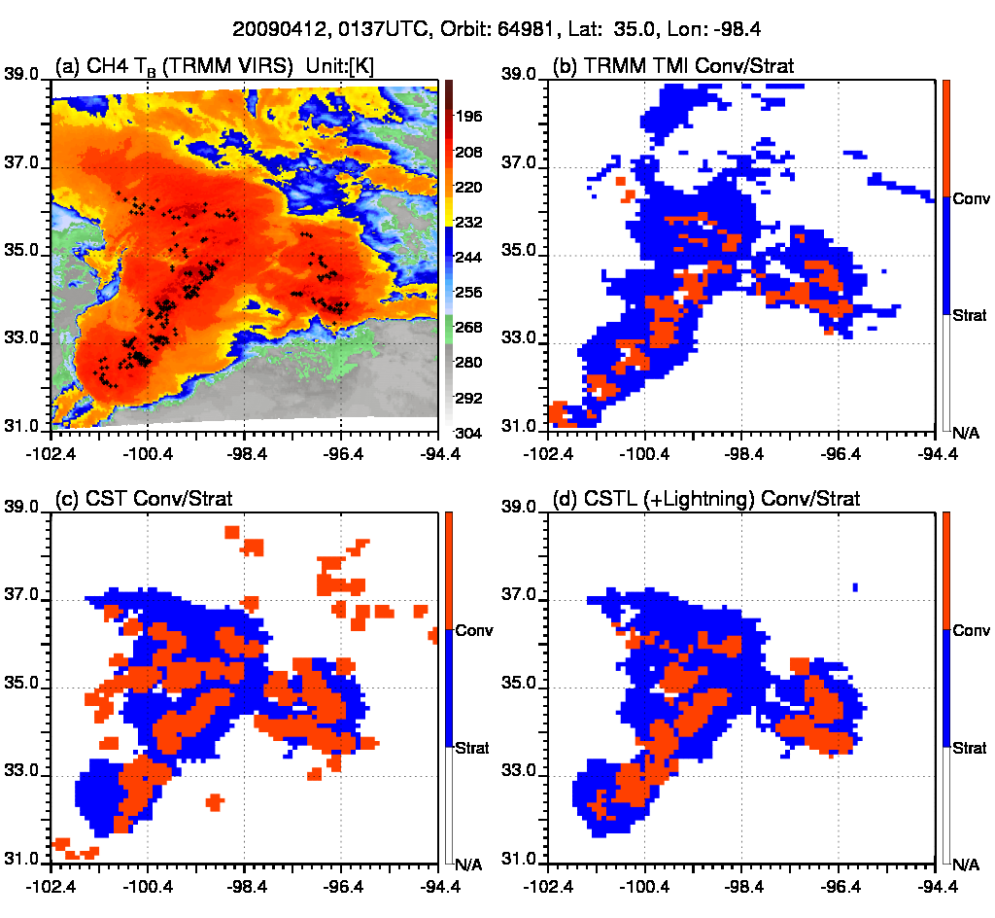
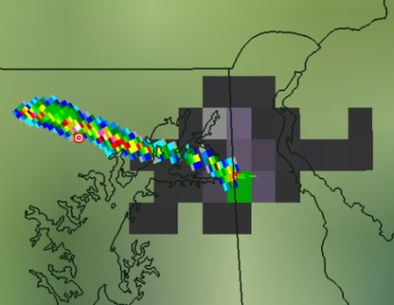
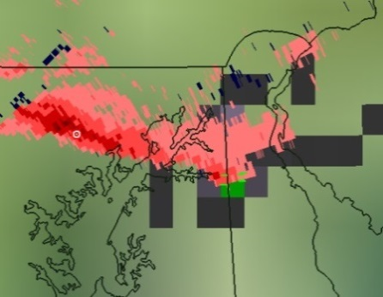
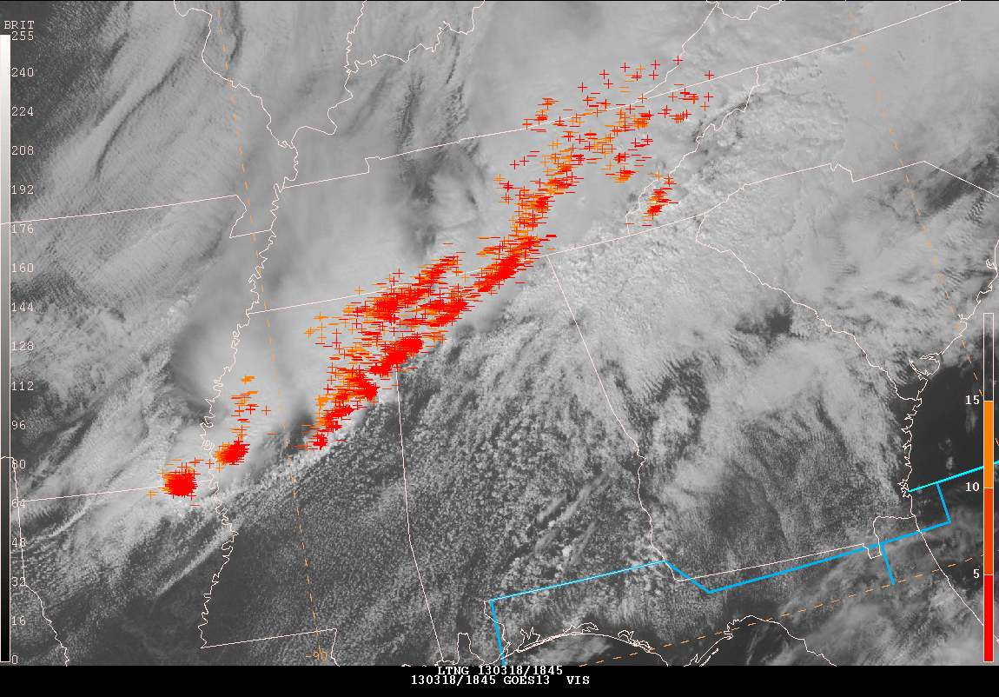
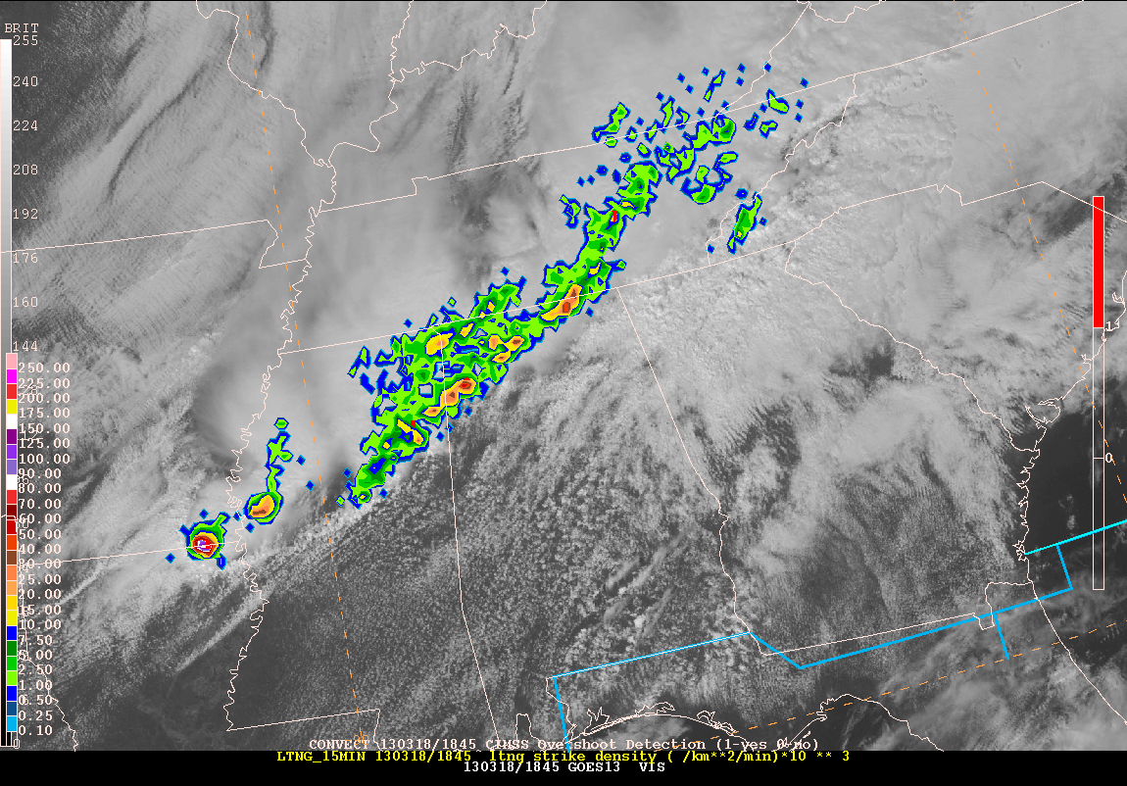
GLM Mission Benefits
Lightning Jumps in Severe Storms
Improving Satellite Precipitation Estimates
Lightning Data Assimilation (Modeling Efforts)
Improving Tropical Cyclone Intensity Forecasts
Lightning Jump
Hail Swath
Rotation Track
Flash
Locations
Flash
Density
Notes:
Lightning Jumps in Severe Storms
Diagnosing convective storm structure and evolution
Improving Satellite Precipitation Estimates
Lightning Data Assimilation (Modeling Efforts)
Improving Tropical Cyclone Intensity Forecasts
Ratio of Inner core versus rain band lightning
Lightning Product Evaluation at OPC
Aviation and marine convective weather hazards

Slide 7
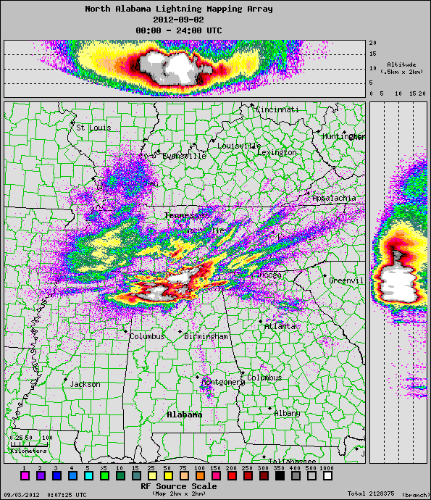
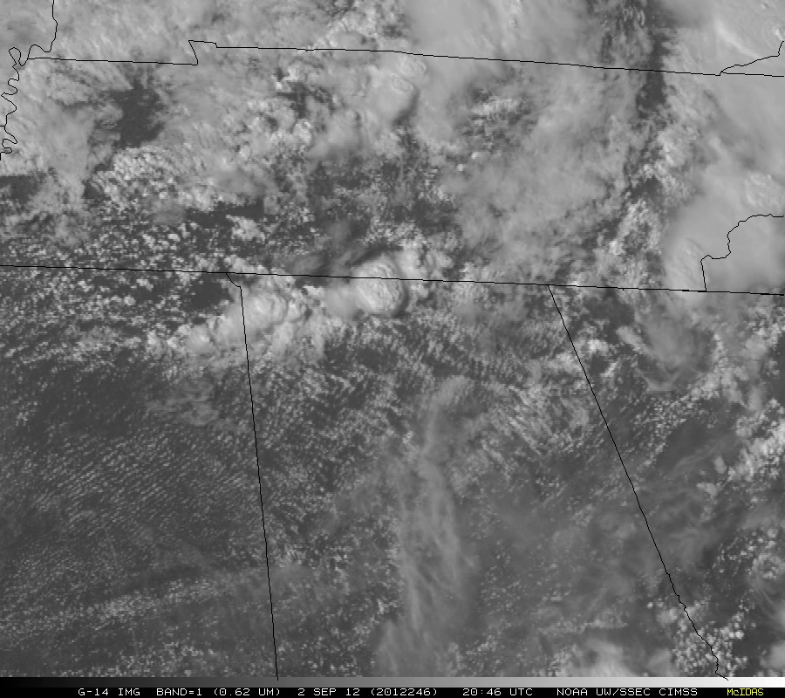
GOES-14 Super-Rapid Scan (SRSOR) Experiment

Slide 8
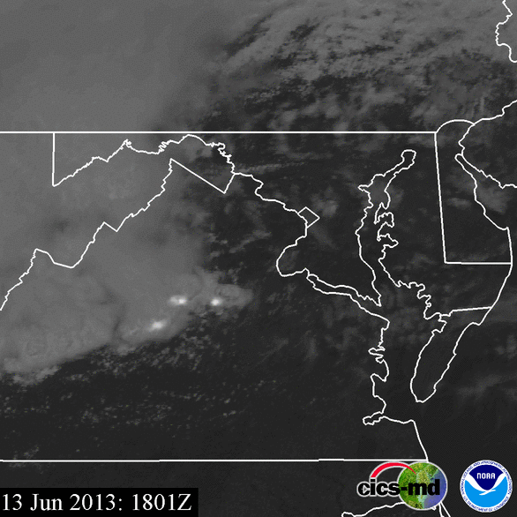
SRSOR plus DCLMA Observations

Slide 9
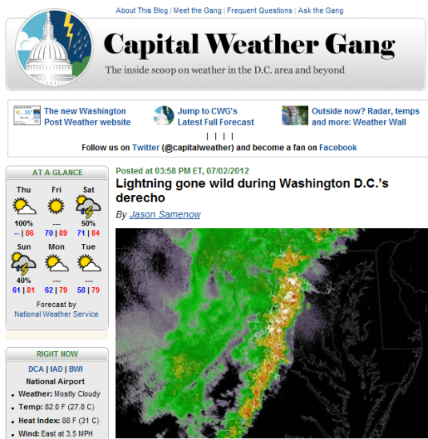
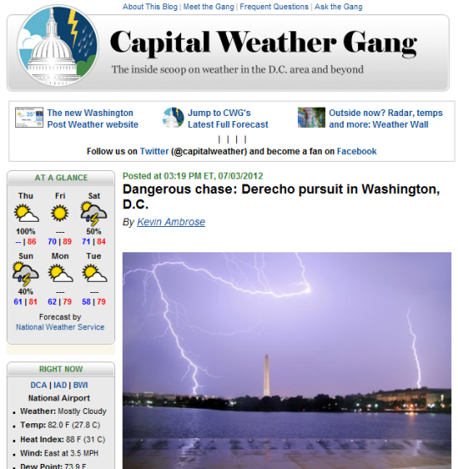
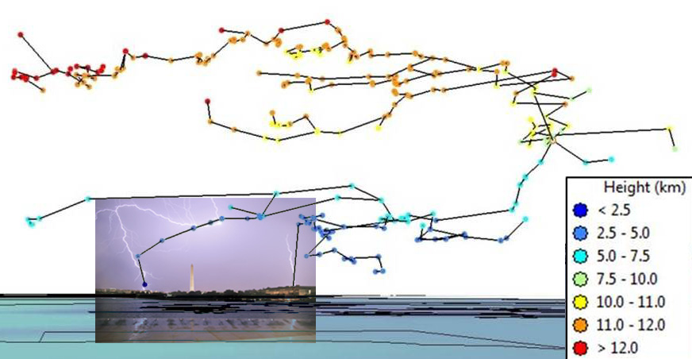
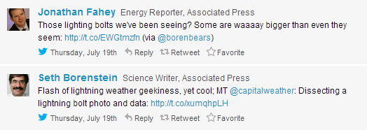
Washington D.C. Lightning Mapping Array
DCLMA is a GOES-R Proving Ground project
Helps prepare for future GLM operations
Provides tremendous outreach opportunities
Washington Post’s Capital Weather Gang

Slide 10
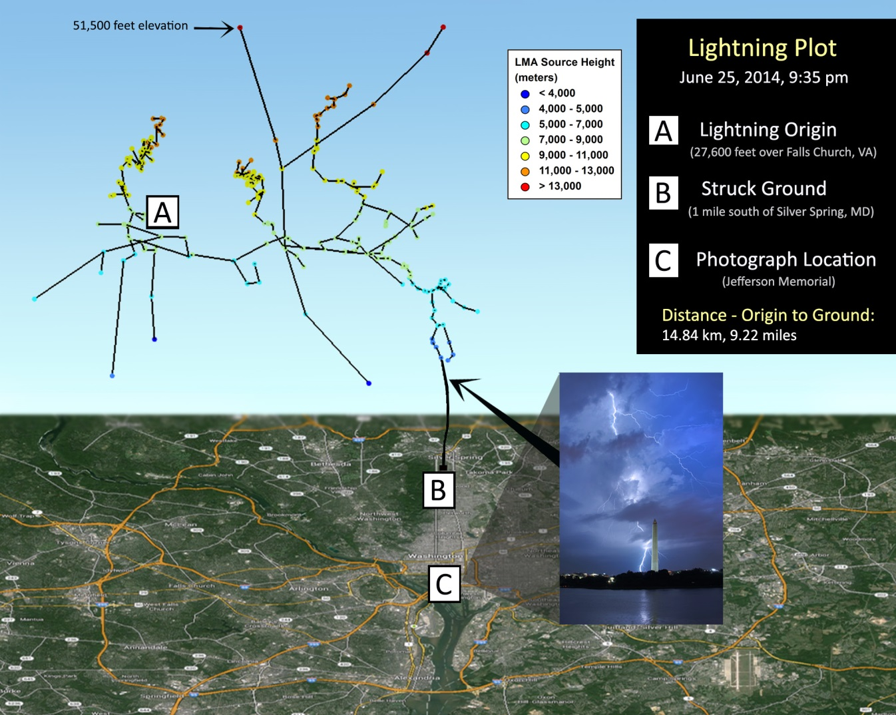
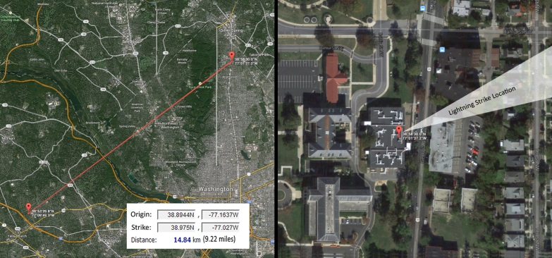
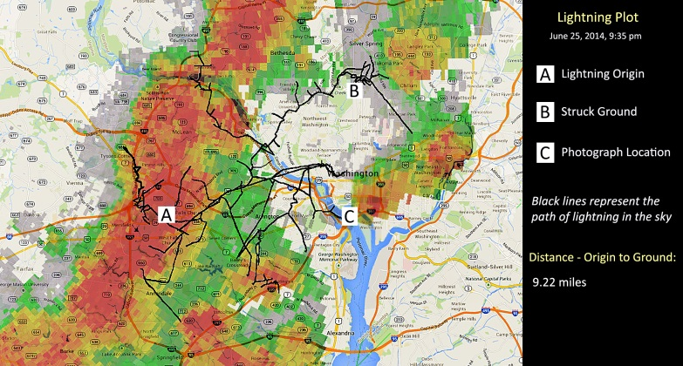
Mapping a “bolt from the blue”: Behind a rogue lightning flash near Silver Spring from a storm in Falls Church
Washington Post’s Capital Weather Gang – 8 July 2014
Kevin Ambrose and Scott Rudlosky

Slide 11
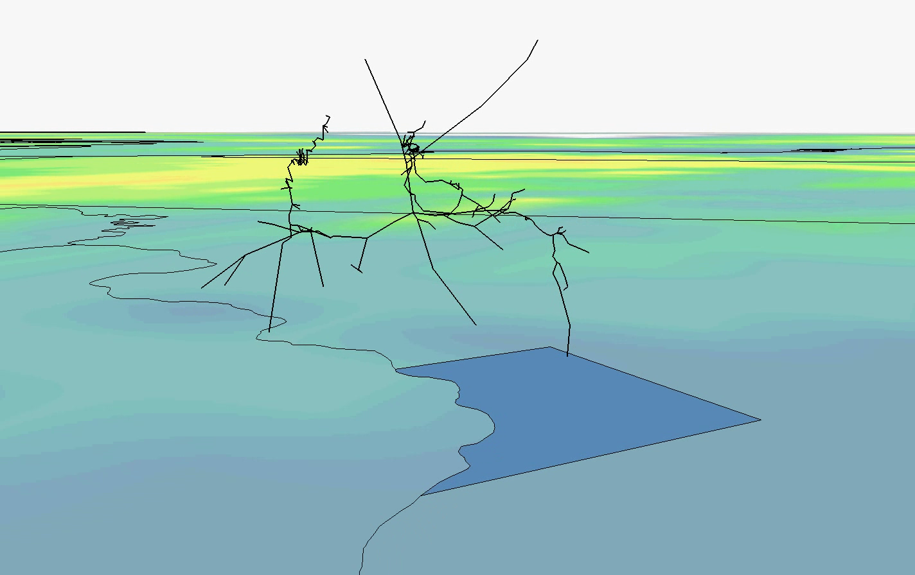
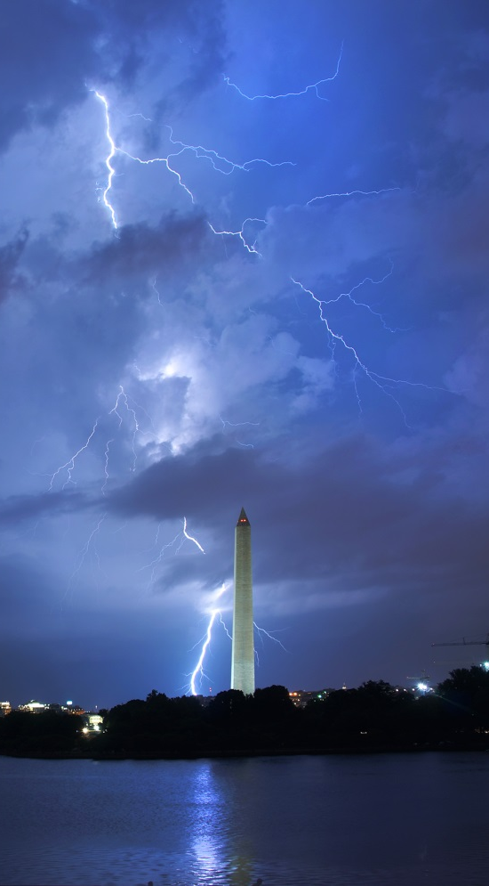
Lightning flash as seen by…
Washington D.C. Lightning Mapping Array
CWG Photographer Kevin Ambrose

Slide 12
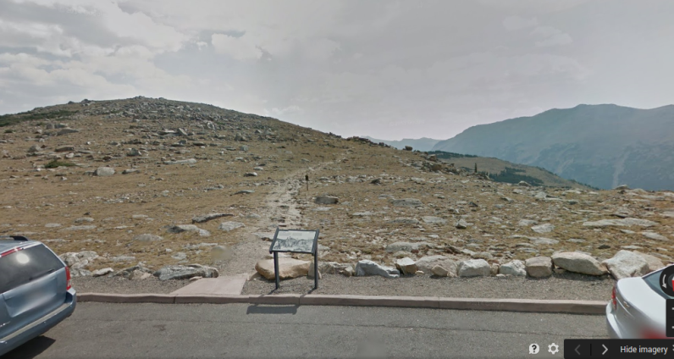
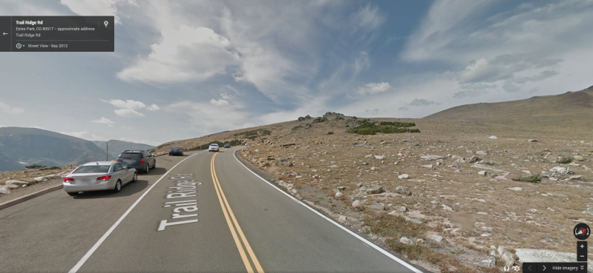
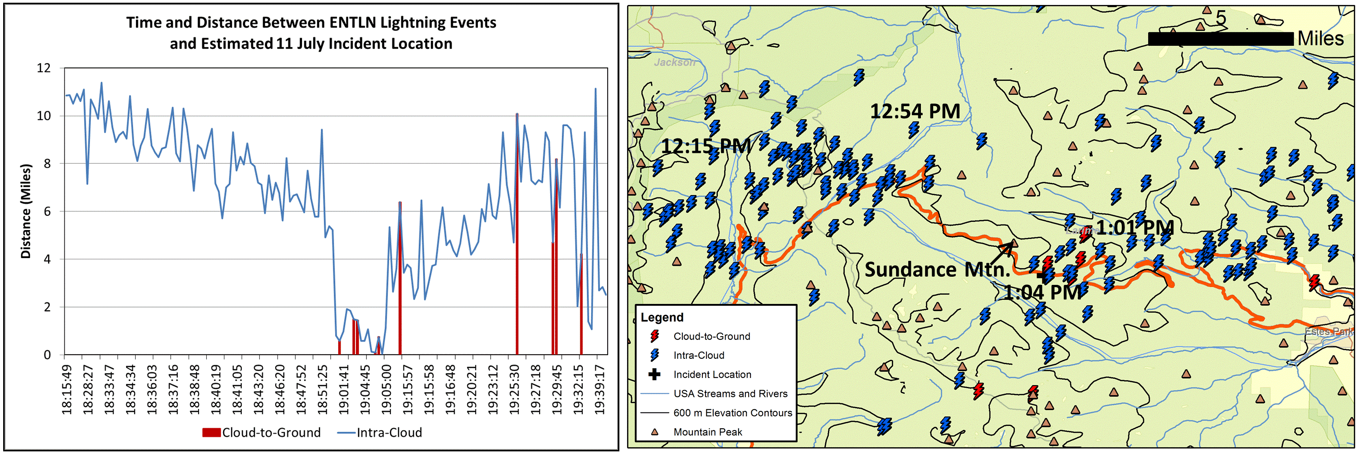
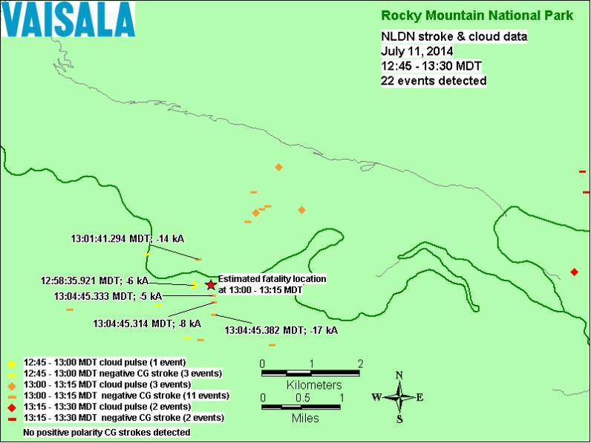
Rocky Mountain National Park – 11 July 2014
Lightning killed one hiker and injured seven
“We were hearing claps of thunder everywhere, but there wasn't any lightning.” (AP)
From the Ute trail head, Sundance Mountain blocked the view of a storm to the northwest
Clouds are nearer to the surface at this altitude, and the rocky terrain distorts the thunder, increasing the confusion and danger

Slide 13
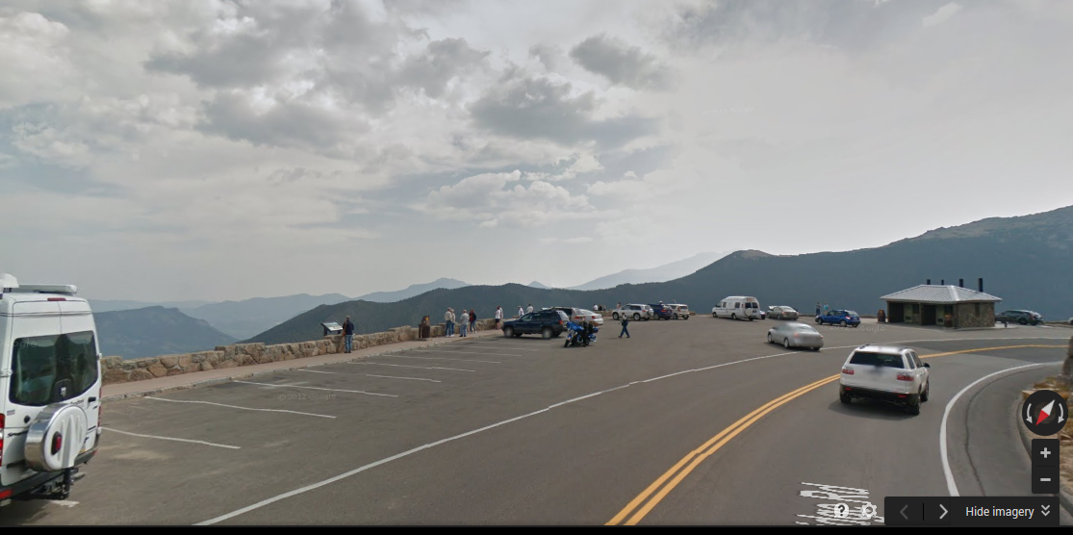
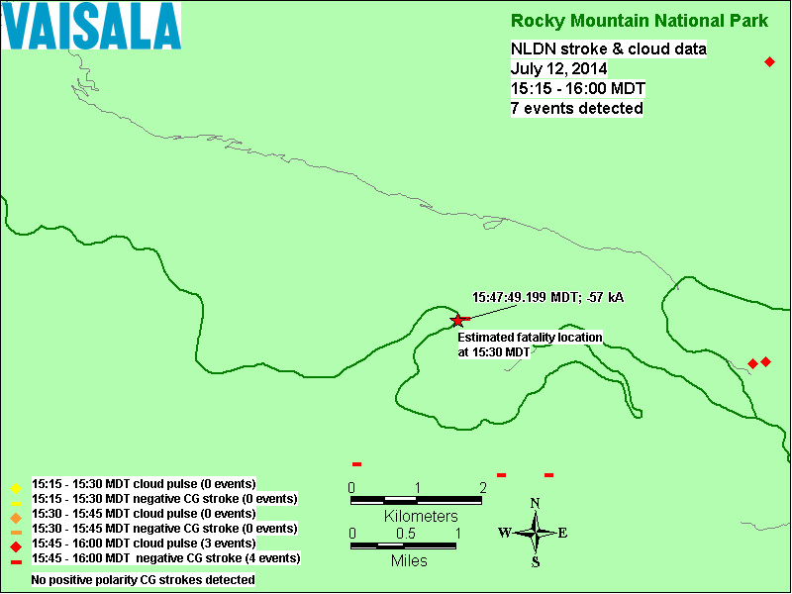
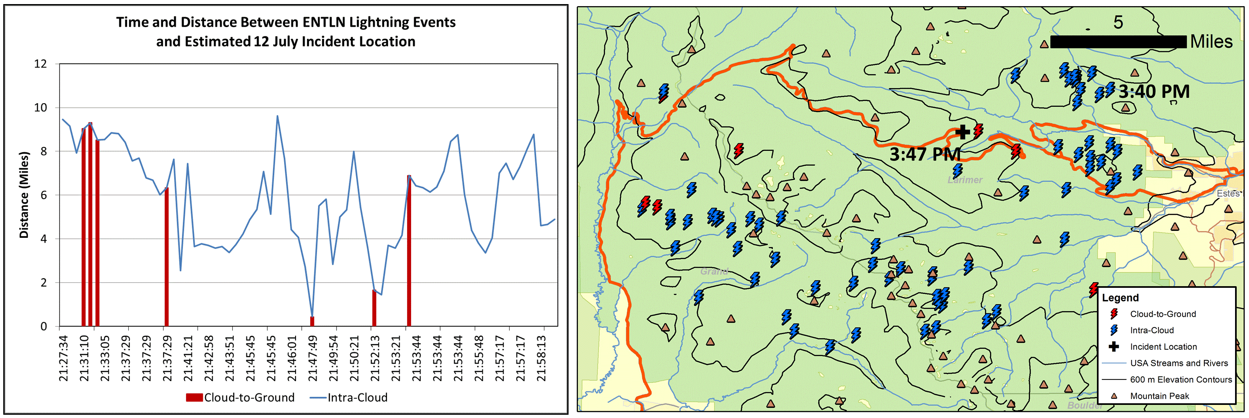
Rocky Mountain National Park – 12 July 2014
Lightning struck the Rainbow Curve parking area, killing one and injuring three
Intermittent lightning was occurring along a distant ridge for at least 45 min preceding the fatal flash
There were no cloud-to-ground flashes within 5 miles of the deadly strike before it suddenly struck
The storm had formed a few miles north less than 30 minutes earlier

Slide 14
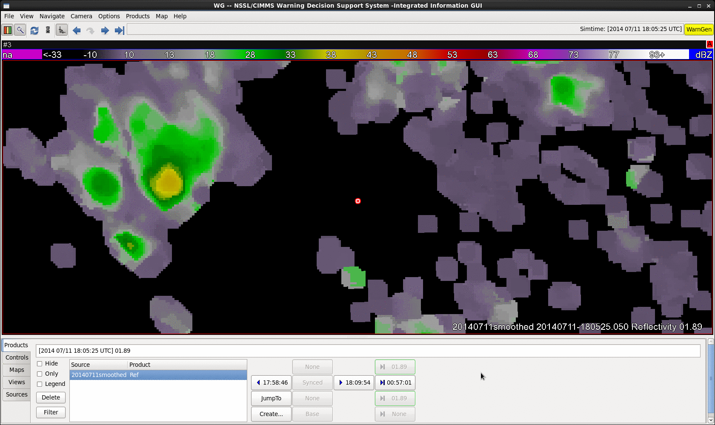
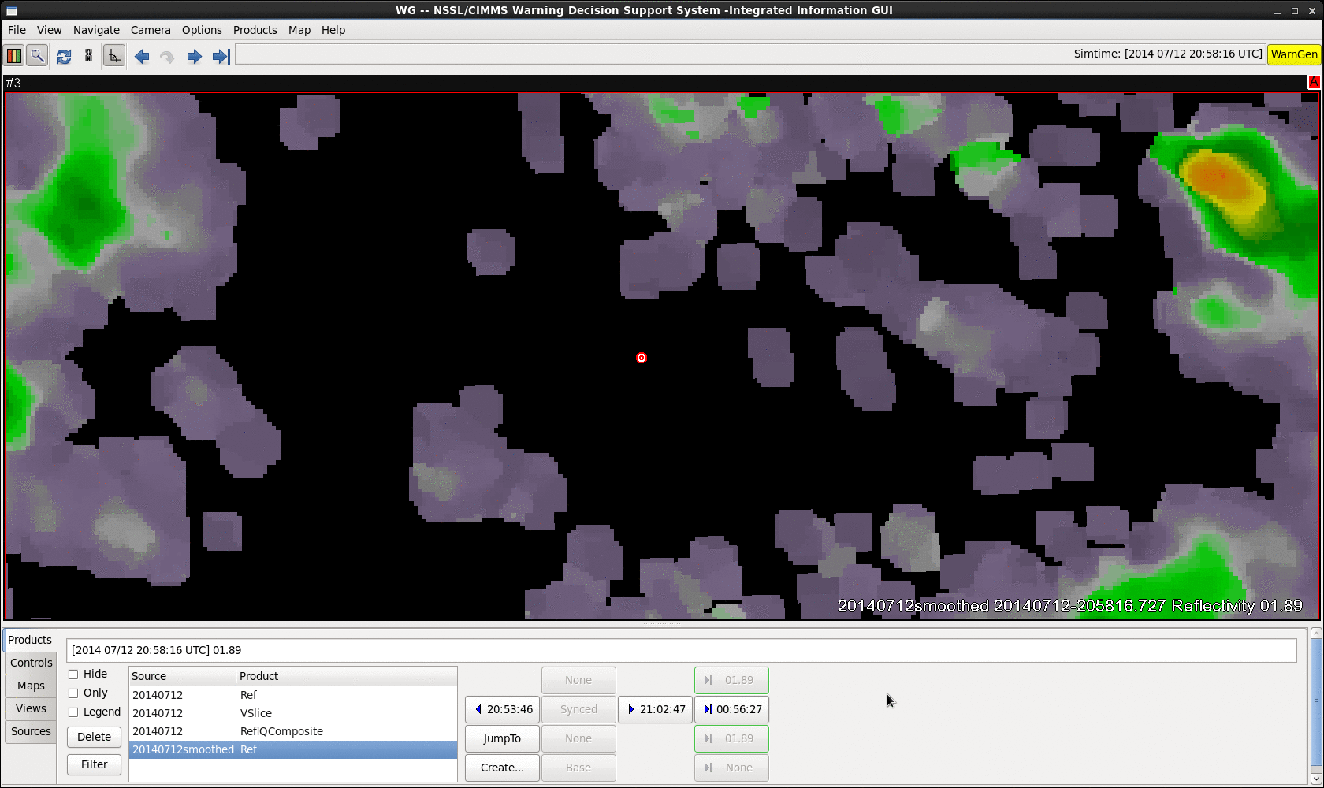
Rocky Mountain National Park Fatalities
Storm cell formed suddenly as outflow from a nearby storm encountered the Ute Ridge
First CG flash occurred less than a mile away and only 3min before the deadly strike, leaving too little time to make it back to the car safely
Radar imagery suggests that this storm formed quickly and passed northeast of the incident location
It appears that a lightning flash exited the side of the storm, traveling more than 2 miles before striking ground
11 July 2014
12 July 2014

Slide 15
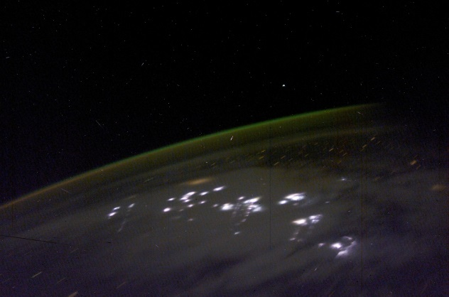
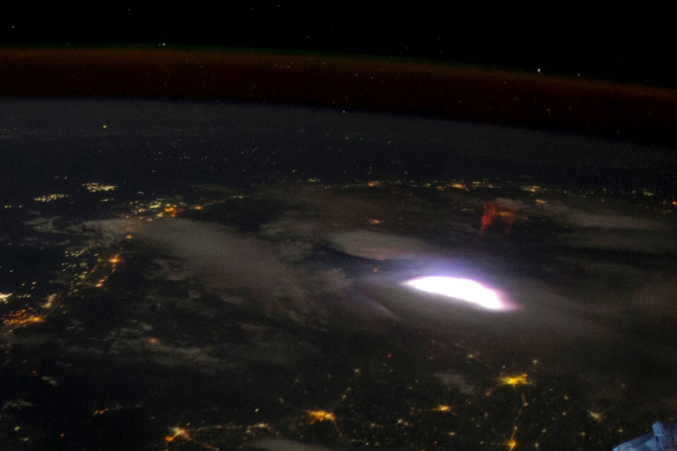
Summary
The GLM will provide total lightning observations at spatial and temporal scales that are currently unavailable
Presently using ground-based networks to prepare forecasters and the general public for the GOES-R era
Many applications will benefit from GLM operations (e.g., lightning jump)
Lightning flashes can travel long distances from their parent storm
Recreational activities often place individuals at greater risk, especially in unfamiliar regions

